Slide 1
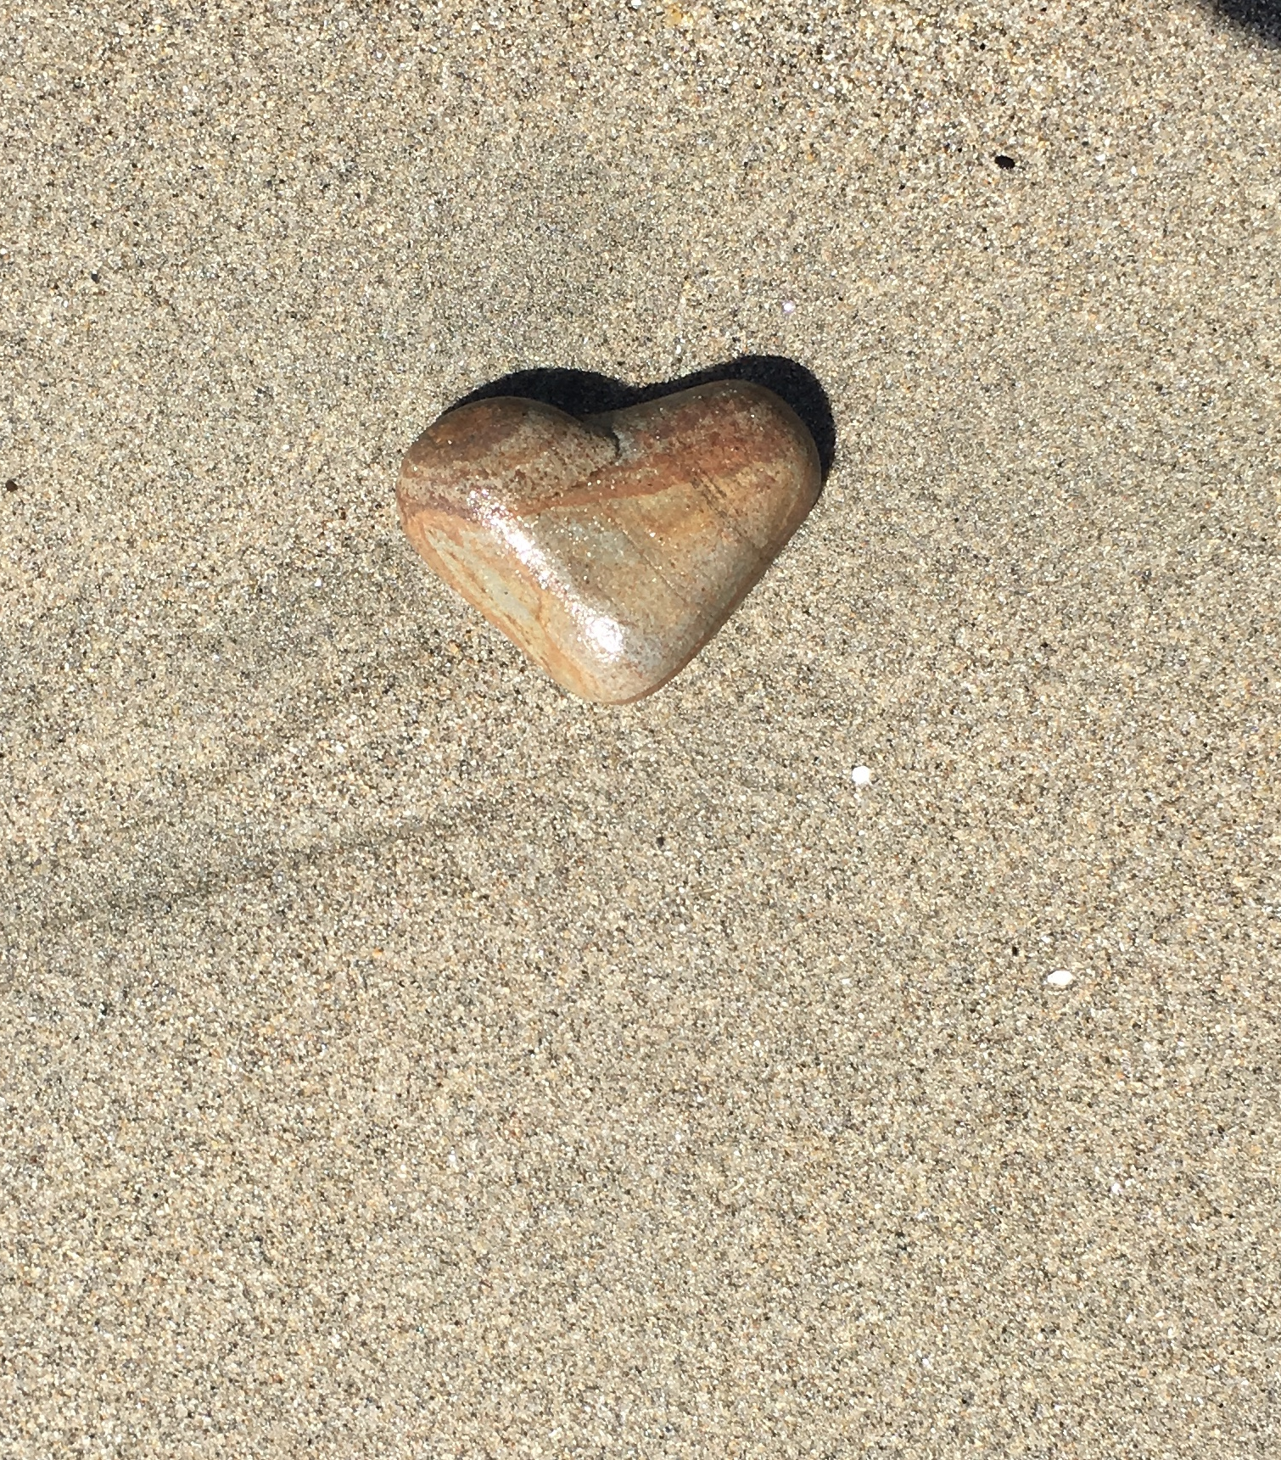
Optimizing Python
Faster, Smaller, and Lower Power

Slide 2
Why? Why are you optimizing? Why optimize Python?
Usual answer to slow scripts: “Just use C. Or C++.”
Smaller systems
Raspberry Pi and other single board computers
TX2 and Nano and other SBCs that do machine learning
CircuitPython and microcontrollers
Smarter systems
AI: ML, DL, SVMs, all the acronyms
Video processing
Notes:
InfoWorld: You answered critics who said that Python is too slow. You said every time you try to write something in Python, it is fast enough. Why is there criticism that it is too slow?
Van Rossum: What people of course do is they pick a tool and they build something incredible, and as part of the incredible thing they're building, they're doing crazy stuff, and sometimes some of the crazy stuff involves doing a whole bunch of computation, crawling through a graph of a billion social contacts or analyzing a trillion email messages or whatever.
At some point, you end up with one little piece of your system, as a whole, where you end up spending all your time. If you write that just as a sort of simple-minded Python loop, at some point you will see that that is the bottleneck in your system. It is usually much more effective to take that one piece and replace that one function or module with a little bit of code you wrote in C or C++ rather than rewriting your entire system in a faster language, because for most of what you're doing, the speed of the language is irrelevant.`

Slide 3


What does it all mean?
Python is interpreted, not compiled. It isn’t always slower.
You should only optimize bottlenecks.
Using print to profile your code is easy though slightly fussy.
There is a built-in Python profiler that is pretty good.
Threads make code go faster but profiling harder.
Deterministic and statistical profilers each have their own place.
Visualization is to profiling as graphs are to data.
Linux tools may be more useful that Python profilers.
GPIOs and oscilloscopes are more fun anyway.
Notes:
If you are nodding along to all of these and could explain them, well, you may be bored. On the other hand if you are giving me your WTF face right now, we are set, this will be great.

Slide 4
Interpreted, not compiled
Let’s look at Compiler Explorer: Godbolt.org
C is compiled to machine code
Compilers are smart (er than me)
Python is interpreted (usually)
Compiled python
Libraries: OpenCV, TensorFlow
MicroPython, CircuitPython
int addTo(int n) {
int i;
int j=0;
for (i = 0; i < n; i++) {
j += i;
}
return j;
}

Slide 5

Optimize the bottlenecks
Identify bottlenecks
Profiling code
Comparing algorithms
Ignore non-essentials
Notes:
Goal of profiling is to find bottlenecks
And to tell you if you’ve made it better
Not going to talk about optimizing, really, depends very much on your code. There are techniques but usually it is about using the language features efficiently, choosing algorithms, and mostly using other peoples code.
But I need something to show you so let’s talk about digits of pi and stack overflow.

Slide 6
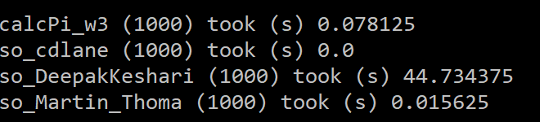
Profiling via Print
Let’s look at opt_timers.py
Verify StackOverflow code works, at least to 100 digits
Note: Prints are outside timed areas!
Notes:
python3
from opt_timers import *
# Test to make sure they work
w3_soln.calcPi(100)
so_DeepakKeshari.calcPi(100)
so_Martin_Thoma.calcPi(100)
so_cdlane.calcPi(100)
# Let’s look at how to time it. Note that the print is outside the timer, even the diff time.
timer_test_1(100)
timer_test_1(1000)
# It is a pain to do a bunch that way to let’s make a function to make it easier but we have to make sure our function is still good
timer_test_2(1000)
# Let’s look at all four algorithms not what we’re pretty sure we are measuring the same thing each time
timer_test_3(1000)
# That cdlane one… let’s try that with a higher number of digits of pi to make sure it is working
timer_test_4(10000)
Choosing between algorithms didn’t even have to look much at them. All so easy.

Slide 7
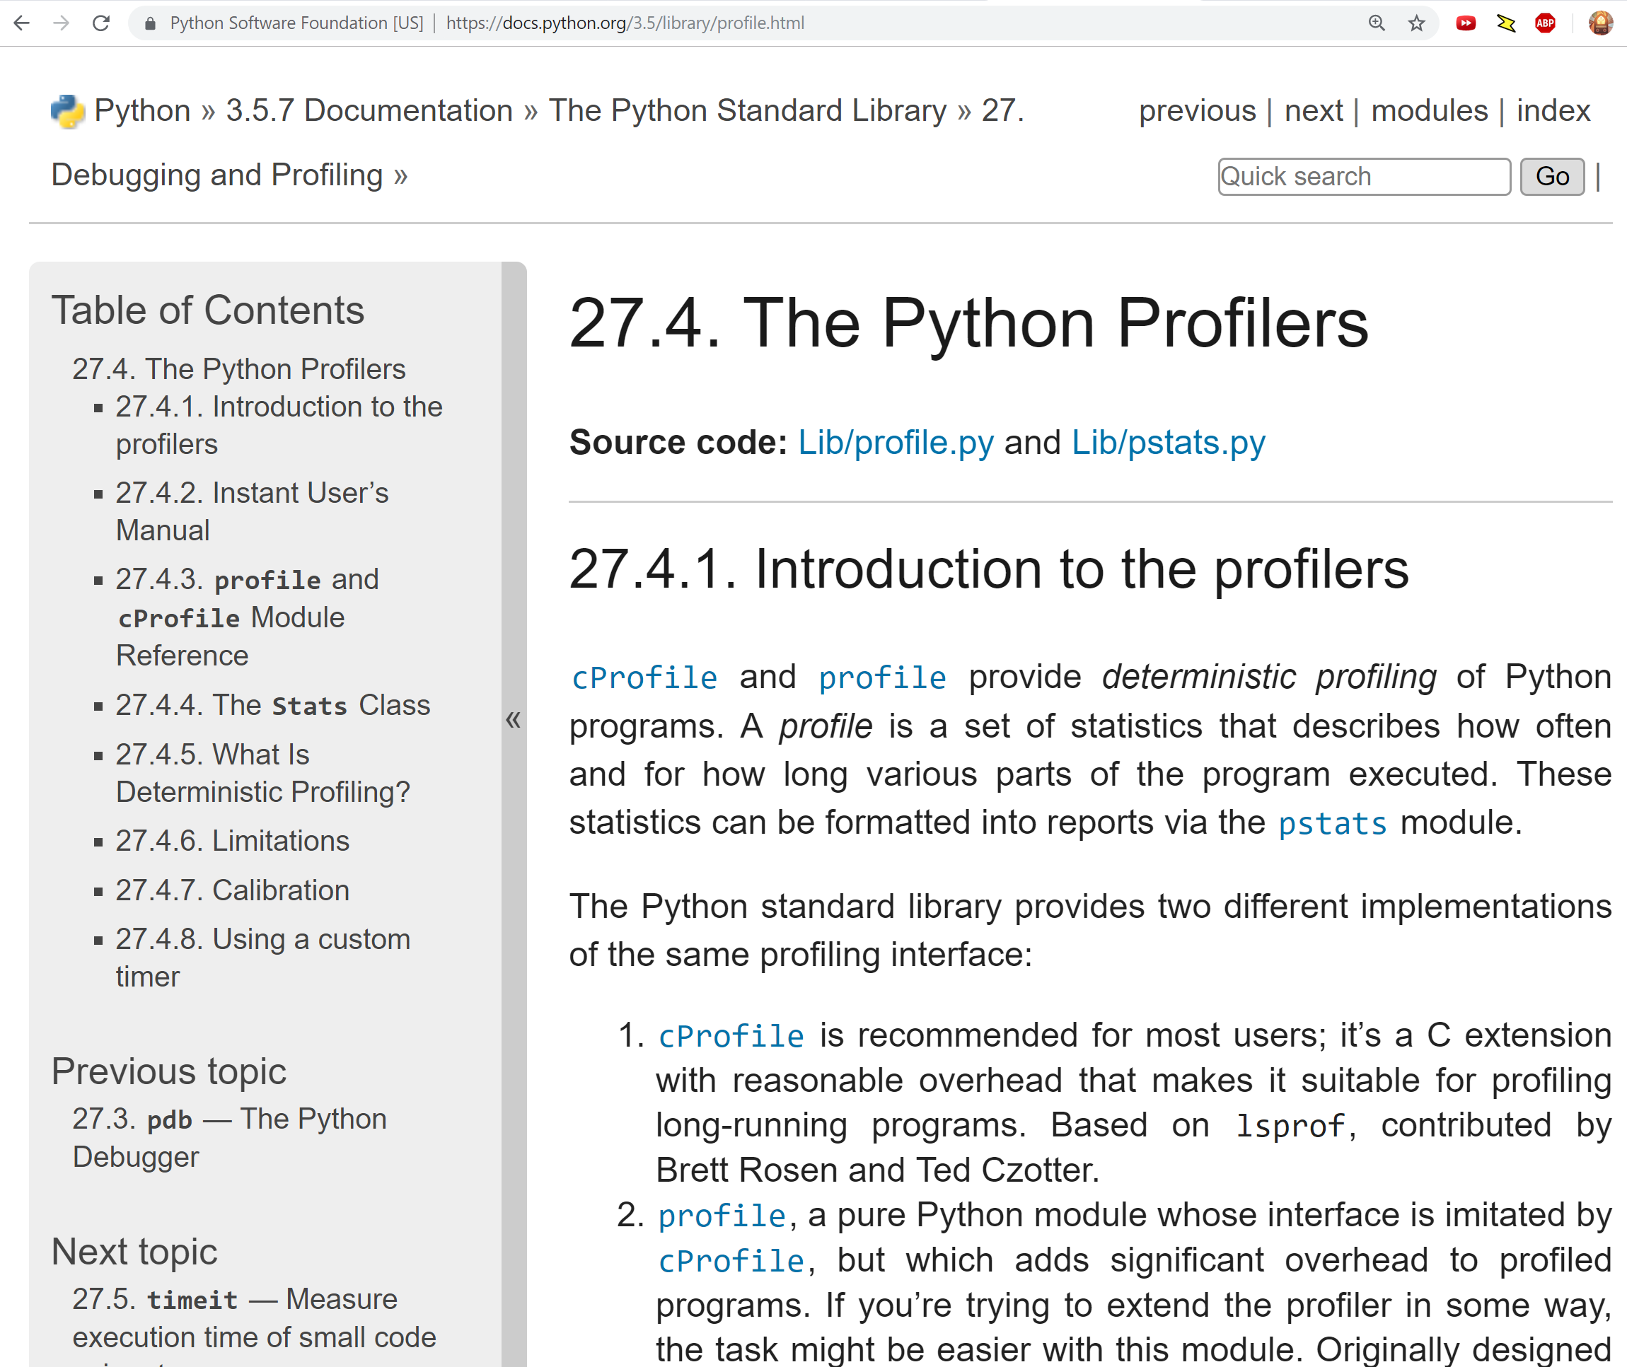
Python’s Built in profiler
Command line or in code
Wall of statistics
Mostly look at cumulative
Look at bottlenecks!
Notes:
# Command line:
# python3 -m cProfile opt_profiler_built_in.py
# Ugly, hard to deal with, bleah
# python3 --help
# python3 -m cProfile -o so_DeepakKeshari.cprof so_DeepakKeshari.py
# lots we can do with that cprof file, it is a standard format lots of tools use…
# Let’s look at these cprof files in python
import pstats
p = pstats.Stats('so_DeepakKeshari.cprof')
p.strip_dirs().sort_stats(-1).print_stats()
p.sort_stats('cumulative').print_stats(10)
# can run the same profiling from inside a python script or shell as well:
import cProfile
import so_DeepakKeshari
cProfile.run('so_DeepakKeshari.calcPi(100)’, so_DeepakKeshari_function.cprof’)
# another cprof file!
# Not going to look at it but we could… or we could do this with areas of codes or functions
# Though there is a better way:
import cProfile, pstats, io
pr = cProfile.Profile()
pr.enable()
so_DeepakKeshari.calcPi(100)
pr.disable()
s = io.StringIO()
sortby = 'cumulative'
ps = pstats.Stats(pr, stream=s).sort_stats(sortby)
ps.print_stats()
print(s.getvalue())

Slide 8
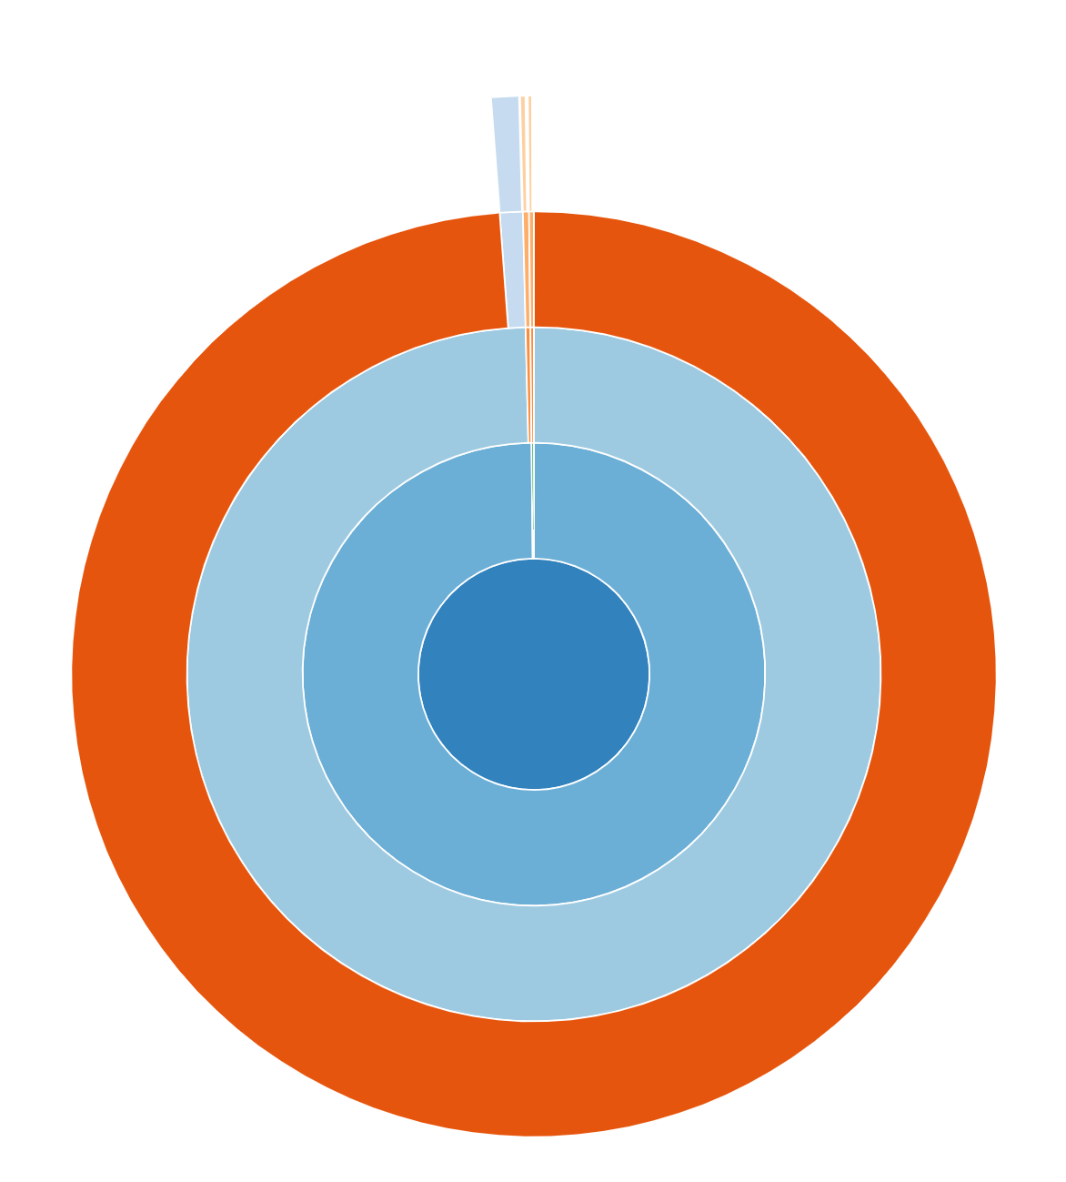
Visualize Whirled Statistics
Notes:
pip3 install snakeviz
snakeviz so_DeepakKeshari.cprof
Browser window: follow paths, different views, look at bottom
snakeviz so_DeepakKeshari_function.cprof
A lot of other cruft, look at just the function
snakeviz so_cdlane_function.cprof
Look at a different function
Builtins are fast, libraries like numpy and tensorflow are fast, you don’t optimize those

Slide 9
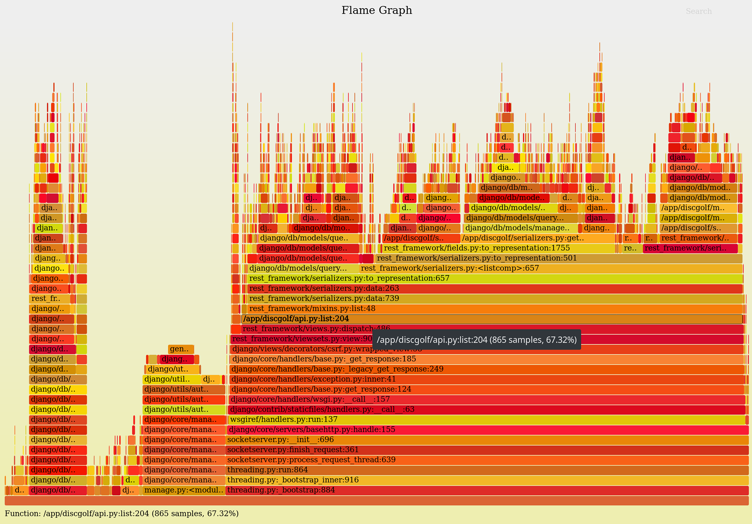
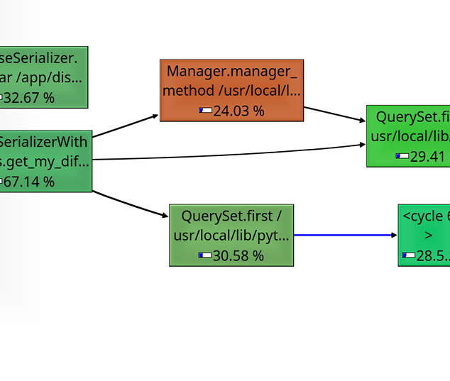
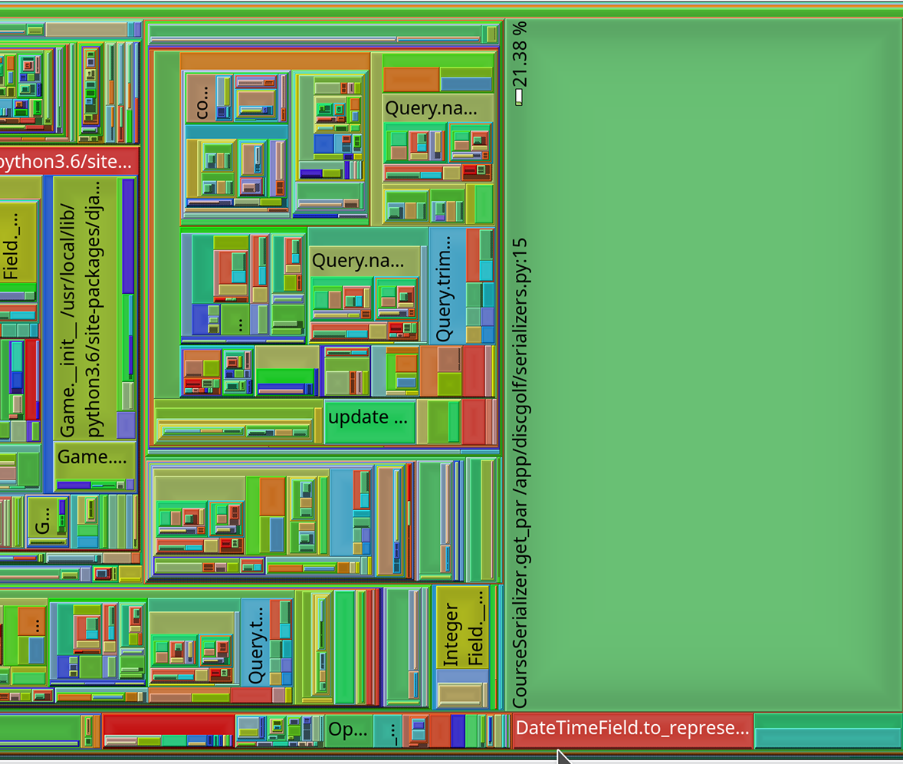
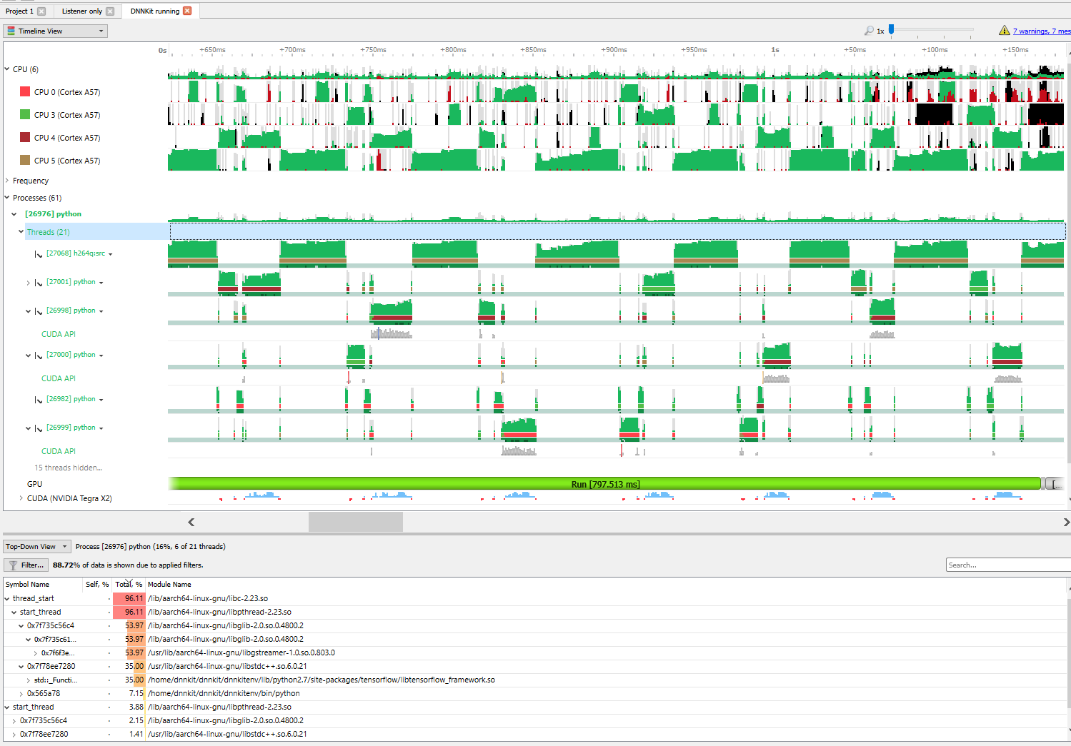
Different Visualizers
Notes:
https://rivolaks.com/posts/profiling-python/
One of them will tell you exactly what you need to know
Mac and Linux are easier

Slide 10
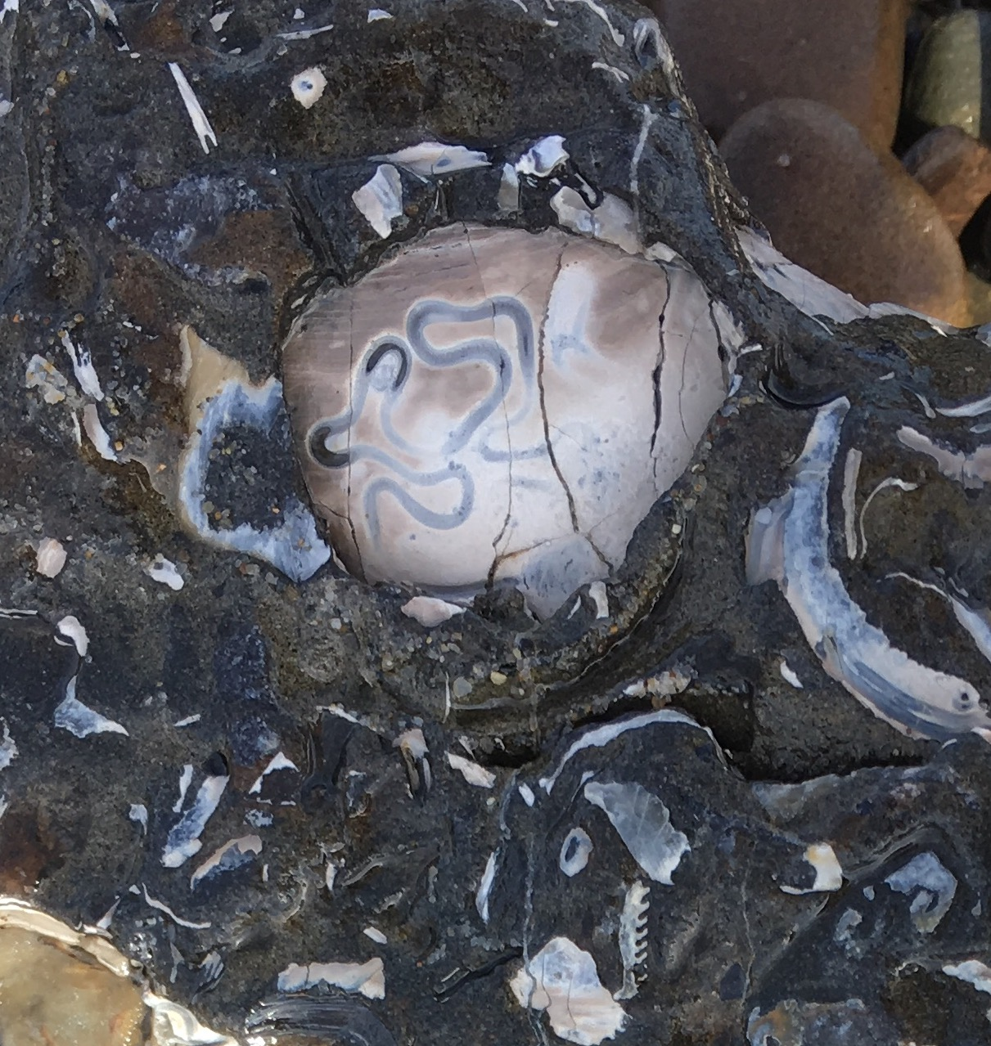
Threads, why did it have to be threads?
Notes:
Why calculate one version of pi at a time, I have four processors?
Global interpreter lock: GIL
You can’t use real threads in python…. Memory management is not thread safe
Unless you use a library like Gstreamer or TensorFlow that cheats

Slide 11
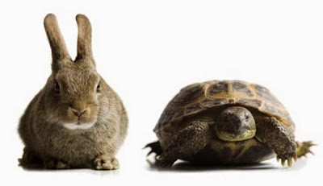
Deterministic vs Statistic
Deterministic:
Follows processor through everything it does.
Logical, orderly, slow
Statistic:
Interrupts CPU: what are you doing now? What about now? Now? Now?
Better for threads, big programs
This Photo by Unknown Author is licensed under CC BY-NC-ND
Notes:
What if instead of following the processor through what it is doing, we could just ask it every once in awhile? Over enough time, it should work out.
Demonstrate a deterministically profiled system of drawing a butterfly. Loosely, each section is timed, like our original timer profilers.
Body
Wing outline
Antenna
Face
Legs
Wing decoration
Other decoration
Background
Everyone, please pull out pen and paper or grab a marker and go to the board.
draw a butterfly
Stop a few times, important to not stop every second precisely because computers have clocks

Slide 12
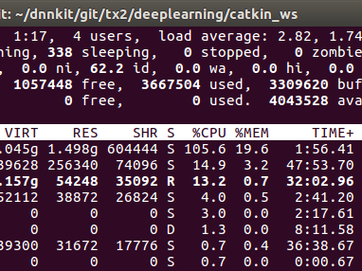
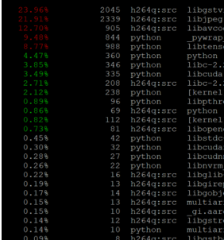
System Tools in Linux top perf: perf top -p <PID> -a -ns comm,dso
Notes:
Sledgehammer tools
Shows everything, big picture
Easy to see where things go but if you are optimizing one thing, easy to get distracted
Ignore init!
Remember: only optimize the bottlenecks

Slide 13
GPIOs and oscilloscopes

Slide 14

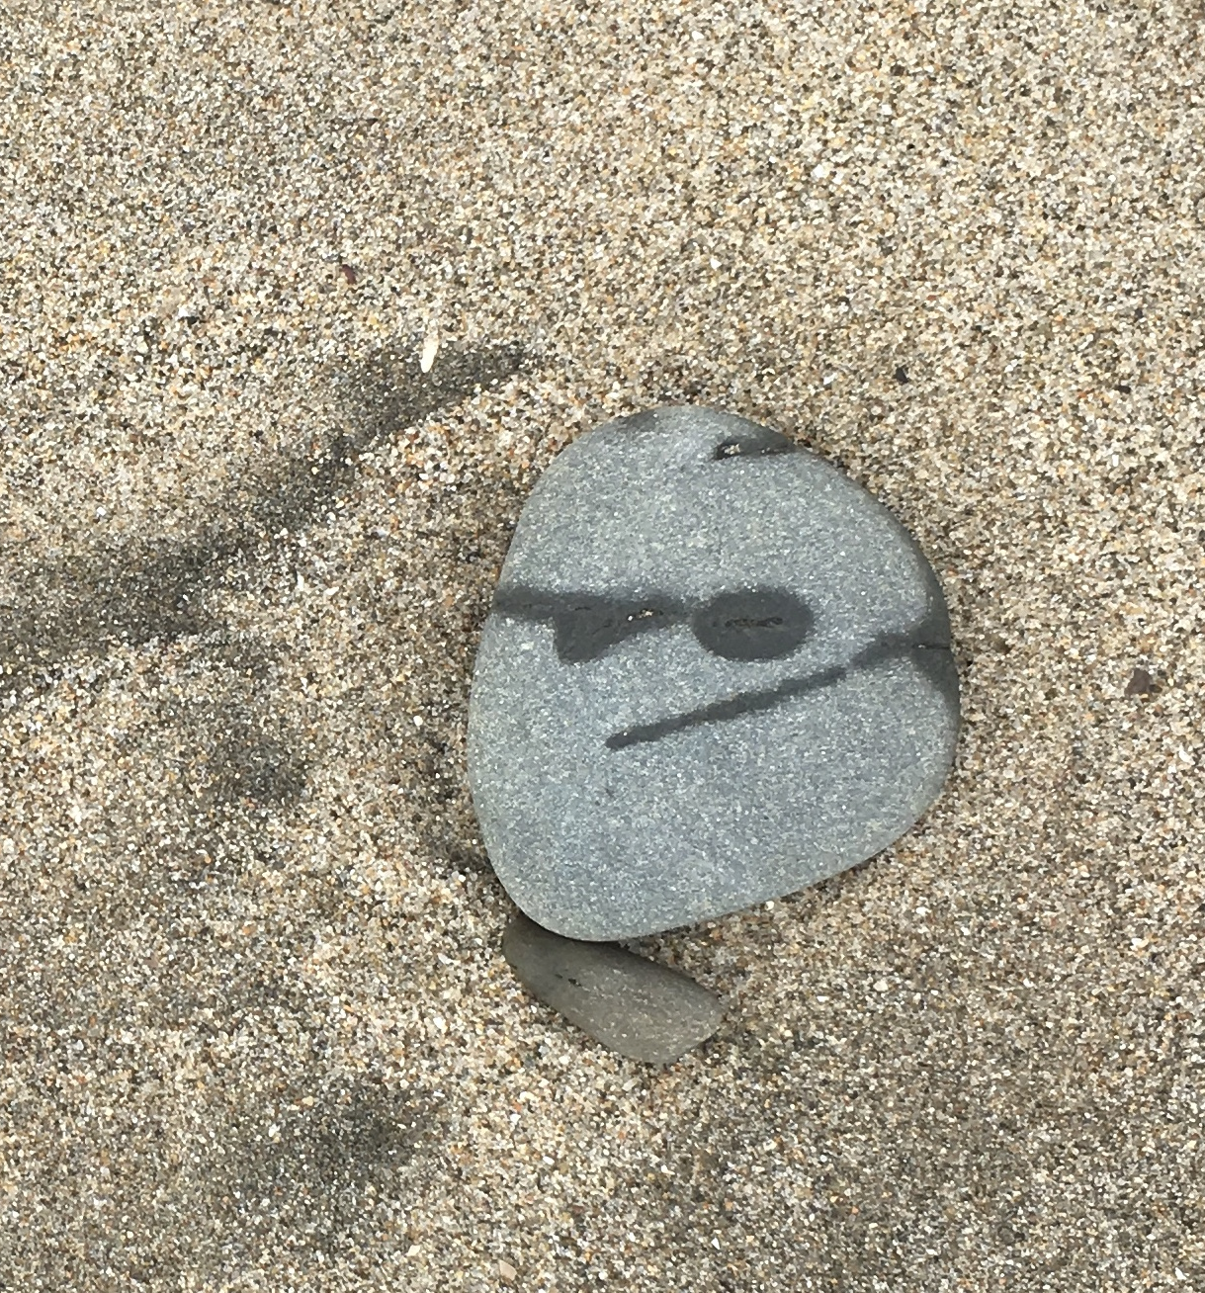
What does it all mean?
Python is interpreted, not compiled. It isn’t always slower.
You should only optimize bottlenecks.
Using print to profile your code is easy though slightly fussy.
There is a built-in Python profiler that is pretty good.
Threads make code go faster but profiling harder.
Deterministic and statistical profilers each have their own place.
Visualization is to profiling as graphs are to data.
Linux tools may be more useful that Python profilers.
GPIOs and oscilloscopes are more fun anyway.
Notes:
Questions about these?

Slide 15

Resources
https://godbolt.org/
Profiling
https://docs.python.org/3.5/library/profile.html
https://julien.danjou.info/guide-to-python-profiling-cprofile-concrete-case-carbonara/
Visualization
https://thirld.com/blog/2014/11/30/visualizing-the-results-of-profiling-python-code/
https://rivolaks.com/posts/profiling-python/
https://eng.uber.com/pyflame/
Global Interpreter Lock (GIL)c
https://realpython.com/python-gil/

Slide 16

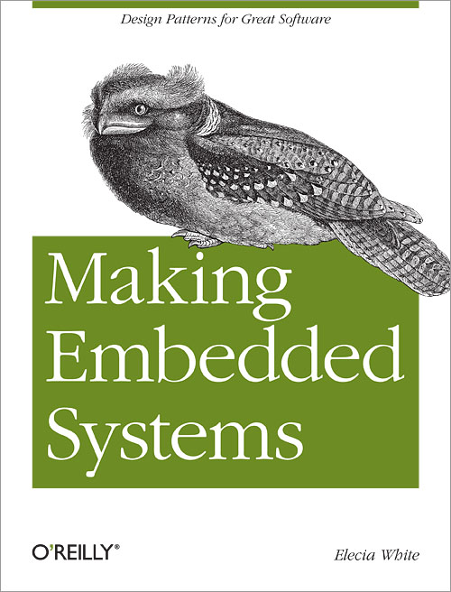
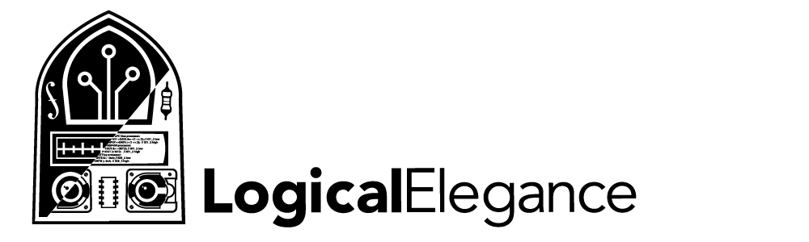
Thank you!
Elecia White
Engineer, Podcast Host, Author
@logicalelegance
Contact link on
embedded.fm or locialelegance.com

